Slide 1
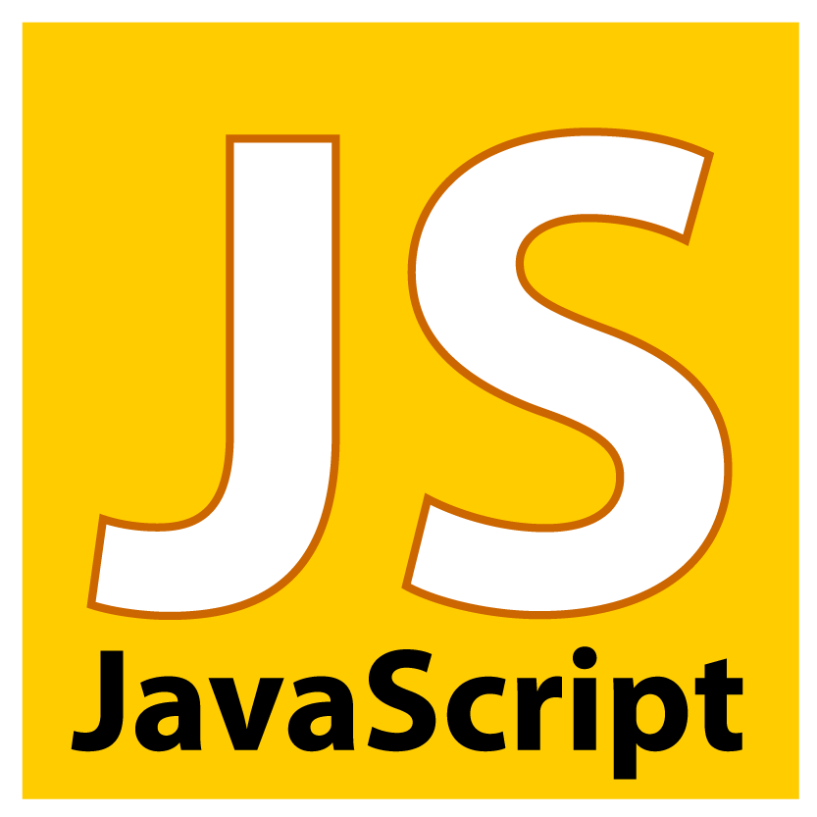

The Software Services
Yours !
Veera Raghava

Slide 2
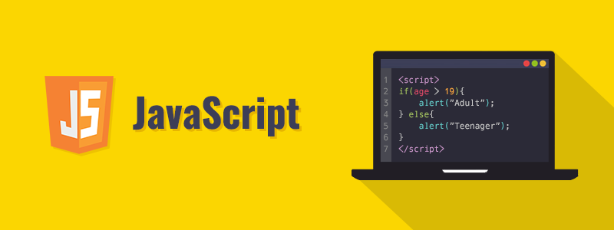
Welcome to JavaScript Basics
Basics

Slide 3
What is JavaScript ?
JavaScript is a open source, object oriented Programming Language primarily used in Front End Web Development as Client Side Scripting Language for HTML and CSS.
Now a days JavaScript is also used as Server Side Scripting language with Node.JS and in Mobile App Developments also.
JavaScript is different from Java both in its design and concept.
JavaScript was originally developed as LiveScript by Netscape in the mid 1990s. It was later renamed to JavaScript in 1995 by Brendan Eich, and became an ECMA standard in 1997.it is also called as ECMAScript (ES).
JavaScript ES 6 version (ECMAScript 2015) is most widely used version and the its latest version is ECMAScript 2018.

Slide 4
Why JavaScript ?
You can modify the content of a web page by adding or removing elements.
You can change the style and position of the elements on a web page.
You can monitor events like mouse click, hover, etc. and react to it.
You can perform and control transitions and animations.
You can create alert pop-ups to display info or warning messages to the user.
You can perform operations based on user inputs and display the results.
You can validate user inputs before submitting it to the server.
Primary Applications :
1) Front End Web Development (Client side scripting, Jquery, Ajax, React JS, Angular JS, Vue JS Frameworks)
2) Back End Web Development (Server side scripting, Node JS, MEAN Stack, MERN Stack etc)
3) Mobile App Development (React Native) and many more…

Slide 5
How to use JavaScript ?
JavaScript can be used in 3 different ways in a web page
1) Inline Javascript
Ex: HTML tag attributes <button onclick=“alert(”Hello World”)>
2) Internal Javascript
Ex: <script> alert(“Hello World”) </script>
Note: ideal place to insert script tags is near to </body> but you can insert script tags in head section also.
3) External JavaScript
Ex: <script src=“javascript_file.js”> </script>
4) Executing JavaScript file with NodeJS interpreter Ex: C:/> node helloworld.js
Javascript statements in Client side is interpreted by Web Browser.
JavaScript is a standard client side scripting language so every Web Browser have JavaScript interpreter inbuilt in it.(Chrome,FireFox etc.)

Slide 6
JavaScript
Part-1
JavaScript Programming Language
Part-2
Applications of JavaScript for Front End Web (DOM Manipulations)

Slide 7
JavaScript Variables :
In any programming language, variables are the names given to memory locations used to hold data for processing.
Raw memory locations are very difficult to remember that’s why we name those memory locations with user friendly names which are called Variables.
Rules for Identifiers (variable names) :
Names can contain letters, digits, underscores, and dollar signs.
Names must begin with a letter but note with a number
Names can also begin with and _
Names are case sensitive (y and Y are different variables)
Reserved words (like JavaScript keywords) cannot be used as names
JavaScript is case-sensitive language
camelCase is recommended for long variable names
In JavaScript for single line comment // is used and for multi line comment /* */ will be used.

Slide 8
JavaScript Variables :
JavaScript Variable should be declared with var keyword (old standard)
Ex :- 1
var name = ‘Sriram’ (string data)
var age = 9 (numeric data)
var pass = true (boolean data)
Ex :- 2
var name = ‘Sriram’ , age = 9 , pass = true
JavaScript Variable should also be declared with let and const keyword (new ES6 standard)
let keyword is used to declare variables ex : let name = ‘Sriram’ let age = 9 let pass = true
const keyword is used to declare only constants but not variables ex: const PI = 3.14
Unlike var keyword which creates functional scope let keyword creates block scope inside { } braces.
Note : we can declare variables without var or let keyword but it is not recommended.

Slide 9
JavaScript Output :
We can print output of JavaScript result mainly in 4 different ways :
1) Output in Browser Screen : document.write(“Hello World”)
2) Output in Browser Console : console.log(“Hello World”)
3) Output as alert dialog in Browser : alert(“Hello World”)
4) Output inside HTML elements : document.getElementById(“txt").innerHTML = "Hello World!"

Slide 10
JavaScript Data Types :
Data Types refers to the various types of data that should be stored in variables for processing.
Primitive Data Types :
1 ) String Data : var wish = ‘Hello World’ or var wish = “Hello World”
2 ) Numeric Data : var num = 20 or var num = 63.5 or var num = 5.2e+4
3 ) Boolean Data : var pass = true or var pass = false
Composite Data Types :
1) Arrays : var games = [ “cricket” , “tennis” , “football” ]
2) Object : var car = { name : “audi” , model : 2019 , engine : ”petrol” }
3) Function : var hello = function(){return “good morning”}
Special Data Types :
1) null : var x = null (means no value but not empty string “ “ or zero)
2) undefined : var firstname alert(firstname) Note : ‘typeof’ keyword will be used to know data type.

Slide 11
JavaScript Operators :
Arithematic Operators :
Operator | Description | Example | Result
+ | Addition | x + y | Sum of x and y
- | Subtraction | x - y | Difference of x and y.
* | Multiplication | x * y | Product of x and y.
/ | Division | x / y | Quotient of x and y
% | Modulus | x % y | Remainder of x divided by y

Slide 12
JavaScript Operators :
Assignment Operators :
Operator | Description | Example | is equivalent to
= | Assign | x = y | x = y
+= | Add and assign | x += y | x = x + y
-= | Subtract and assign | x -= y | x = x - y
*= | Multiply and assign | x *= y | x = x * y
/= | Divide and assign quotient | x /= y | x = x / y
%= | Divide and assign modulus | x %= y | x = x % y

Slide 13
JavaScript Operators :
Increment & Decrement Operators :
Operator | Name | Effect
++x | Pre-increment | Increments x by one, then returns x
x++ | Post-increment | Returns x, then increments x by one
--x | Pre-decrement | Decrements x by one, then returns x
x-- | Post-decrement | Returns x, then decrements x by one

Slide 14
JavaScript Operators :
Logical Operators :
Operator | Name | Example | Result
&& | And | x && y | True if both x and y are true
|| | Or | x || y | True if either x or y is true
! | Not | !x | True if x is not true

Slide 15
JavaScript Operators :
Comparision Operators :
Operator | Name | Example | Result
== | Equal | x == y | True if x is equal to y
=== | Identical | x === y | True if x is equal to y, and they are of the same type
!= | Not equal | x != y | True if x is not equal to y
!== | Not identical | x !== y | True if x is not equal to y, or they are not of the same type
< | Less than | x < y | True if x is less than y
> | Greater than | x > y | True if x is greater than y
>= | Greater than or equal to | x >= y | True if x is greater than or equal to y
<= | Less than or equal to | x <= y | True if x is less than or equal to y

Slide 16
JavaScript Mutables and Immutables :
Immutable : whose state cannot be modified after it is created.(i.e in memory modifications is not possible,new memory block will be used for storing modified data)
Ex : Numbers and Strings
var x = 10 (say the value is stored at memory address 0x1234)
x = 20 (the new value will stored in some other memory address say 0x5462)
x++
Mutable : whose state can be modified (i.e in memory modifications can be done at the same memory location itself)
Ex: Arrays , Objects , Functions
var cars = [‘audi’ , ‘bmw’ , ‘honda’] (say value stored at memory address 0x4567)
cars[0] = ‘benz’ (the modified value will be stored at same memory address 0x4567)

Slide 17
JavaScript Number Methods :
Generally Primitive Data Types does not have methods and properties associated with them because those are not objects but in JavaScript Primitive Data Types like Numbers, Strings have methods and properties.
toString() : returns a number as a string.
var x = 10
x.toString()
(45).toString()
(26+84).toString()
toExponential() : returns a string, with a number rounded and written using exponential notation.
var x = 5.8
x.toExponontial(2)
toFixed() : returns a string, with the number written with a specified number of decimals
var x = 3.645
x.toFixed(2)

Slide 18
JavaScript Number Methods :
toPrecision() : returns a string, with a number written with a specified length
var x = 4.758
x.toPrecision(3)
valueOf() : returns a number as a number.
var x = 59
x.valueOf()
(45).valueOf()
Number() : used to convert JavaScript variables to numbers
Number(true)
Number(false)
Number(“28”)
Number(“45.6”)
Number(“Hello”) NaN

Slide 19
JavaScript Number Methods :
parseInt() : parses a string and returns a whole number. Spaces are allowed. Only the first number is returned
parseInt(“10”)
parseInt(“25.88”)
parseFloat() : parses a string and returns a number. Spaces are allowed. Only the first number is returned
parseFloat(“58.67”)

Slide 20
JavaScript String Methods :
String Length : length property returns the length of a string
var name = “siva”
name.length
indexOf() : method returns the index of (the position of) the first occurrence of a specified text in a string
var txt = “Hello how r you iam fine”
txt.indexOf(“you”)
slice() : extracts a part of a string and returns the extracted part in a new string
var txt = “Hello how r you iam fine”
txt.slice(5,9) or txt.slice(-5)
substring() : it is similar to slice but substring does not accept negative indexes.
var txt = “Hello how r you iam fine”
txt.substring(4,8)

Slide 21
JavaScript String Methods :
replace() : method replaces a specified value with another value in a string
var txt = “Hello how r you iam fine”
txt.replace(“fine”,”good”)
toUpperCase() : converts a string to upper case
var txt = “Hello how r you iam fine”
txt.toUpperCase()
toLowerCase() : converts a string to lower case
var txt = “Hello how r you iam fine”
txt.toLowerCase()
concat() : joins two or more string together
var txt1 = “hello”
var txt2 = “world”
txt1.concat(“ “ , text2)
txt1 + txt 2 (string concatenation with + operator)

Slide 22
JavaScript String Methods :
trim() : method removes whitespace from both sides of a string
var txt = “ apple ‘’
txt.trim()
String Subscript : [ ] is used to access characters of a string.
var txt = “coffee”
txt[0]
split() : used to convert string to an Array
var txt = “a,b,c,d,e”
txt.split(“,”) or (“ “) or (“|”)

Slide 23
JavaScript Array Methods :
Array Length : length property is used to return the length of an array
var car = [‘bmw’ , ‘benz’ , ‘audi’]
car.length
Looping an Array :
for(var i=0 i<car.length i++) { console.log(car[i]) }
for(var i of car) {console.log(i) } ES6 new feature
push() : Adds new element at end of Array
var car = [‘bmw’ , ‘benz’ , ‘audi’]
car.push(“honda”) or car.unshift(“honda”) // adds element at index 0
pop() : Removes an last element from Array
var car = [‘bmw’ , ‘benz’ , ‘audi’]
car.pop() or car.shift() // removes element at index 0

Slide 24
JavaScript Array Methods :
splice() : it can remove any element at any position
syntax : arr.splice(start_index, del_count , element1,……elementN)
var car = [‘bmw’ , ‘benz’ , ‘audi’]
car.splice(1,1)
car.splice(1,0,’honda’,’maruthi’)
join() : joins array elements together to form a string
var car = [‘bmw’ , ‘benz’ , ‘audi’]
car.join() or (“ “ ) or (“-”)
car.toString() // default comma separated elements
slice() : extracts a portion of an array
var car = [‘bmw’ , ‘benz’ , ‘audi’]
car.slice(0,1)
concat() : used to merge to arrays
var car1 = [‘bmw’ , ‘benz’ , ‘audi’]
var car2 = [‘maruthi’ , ‘honda’ , ‘skoda’]
car1.concat(car2)

Slide 25
JavaScript Objects :
JavaScript Object :
var person = { ‘name’: siva , age:5 , ‘gender’:’male’ }
Accessing Object Data :
person[‘name’] or person.name
Adding new data to Object :
person[‘name’] = ‘Sriram’ or person.name = ‘Sriram’
Deleting Object Data :
delete person[‘name’] or delete person.name
Looping through Objects :
for(var i in person) { console.log(i) }
Calling Object Methods :
var person = { ‘name’: siva , age:5 , ‘gender’:’male’ , displayName: function(){console.log(this.name)}}
person.displayName() Note : this keyword means current object

Slide 26
JavaScript Decision Making :
Decision Making or Selection Statements :
if statement
if else statement
if elseif else statement
switch case statement

Slide 27
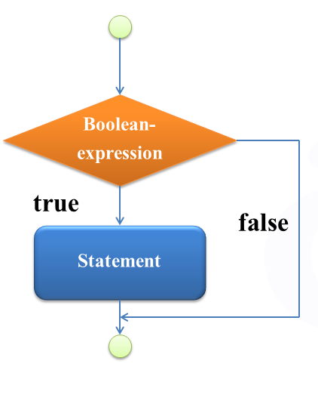
JavaScript if statement :
if statement is used to select a block of statements based on certain condition become true, other wise general execution flow continues.
Syntax :
if (condition) {
Block of Statements
}
next statements…
Ex : if(age > 18){
console.log(“you r permitted to vote”)
}
console.log(10+20)

Slide 28
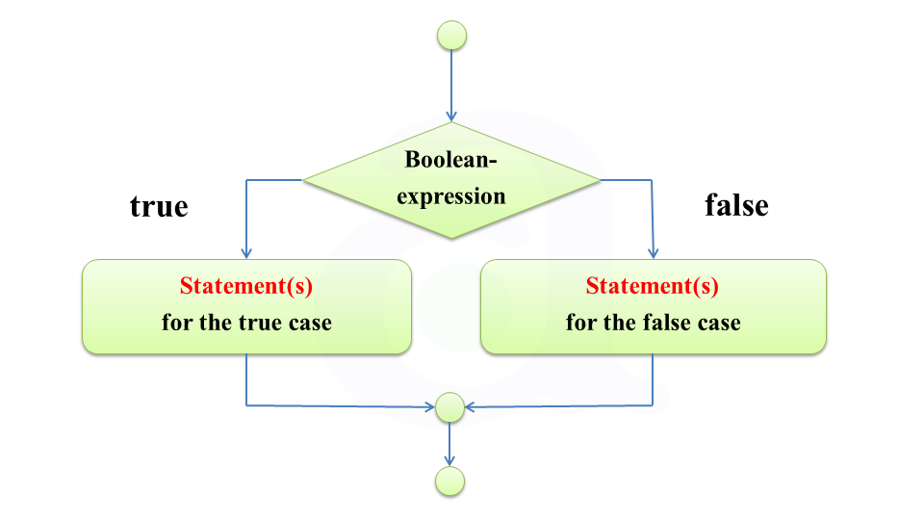
JavaScript if else statement :
if-else statement is used to select a block of statements based on condition become true otherwise if condition become false then it will select alternate block of statements called else block.
Syntax :
if (condition) {
Block of Statements
}
else{
Block of Statements
}
next statements…
Ex : if(age > 18){
console.log(“you r permitted to vote”)
}
else{
console.log(“you r not permitted to vote”)
}
console.log(10+20)

Slide 29
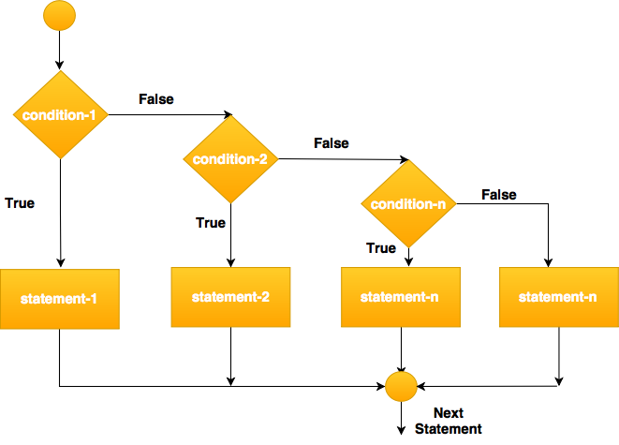
JavaScript if - elseif - else Statement :
if elseif else statement is used to when there is requirement to check multiple conditions.
hdhdrzhxfdthxdghx
Syntax :
if (condition-1) {
Block of Statements
}
else if(condition-2){
Block of Statements
}
else if(condition-3){
Block of Statements
}
else {
Block of Statements
}
next statements…
Ex :
if(x>y && x>z){
console.log(“x is greater”)
}
else if(y>x && y>z){
console.log(“y is greater”)
}
….
else{
console.log(“z is greater”)
}

Slide 30
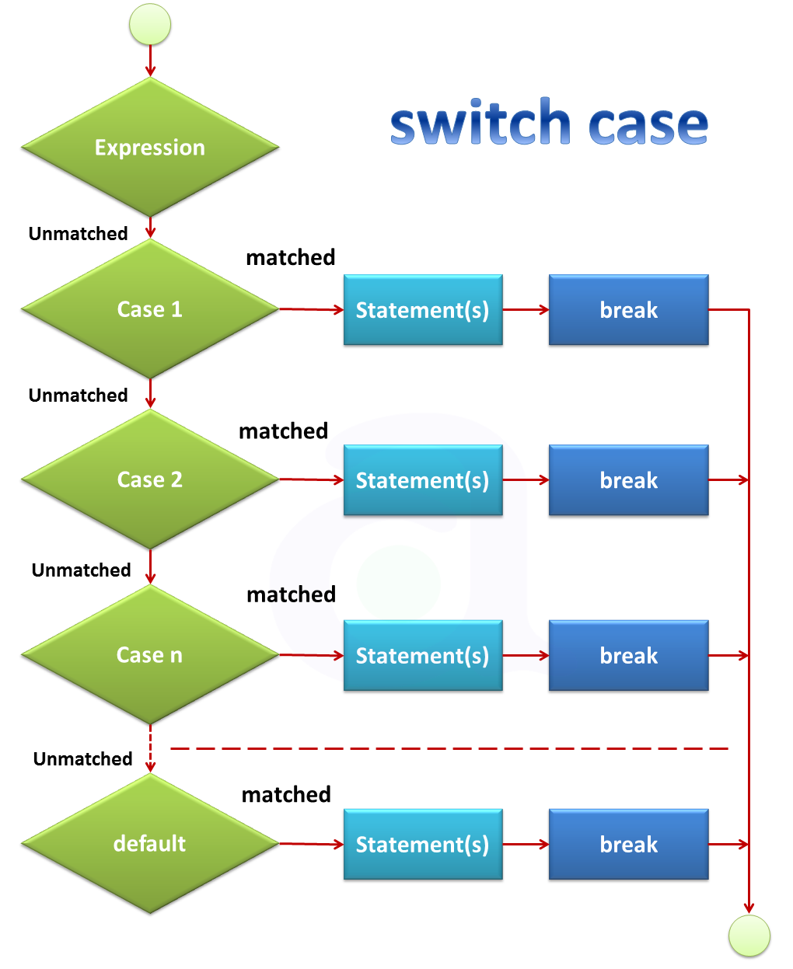
JavaScript switch case statement :
switch case is used to select appropriate block of statements when the case equals to the specified condition.
Syntax :
switch (expression) {
case (value-1) :
Block of Statements
break
case (value-2) :
Block of Statements
break
default :
Block of Statements
break
}
next statements…
Ex :
var day = ’sun'
switch (day){
case ’mon':
console.log(“mon")
break
case ’tue':
console.log(‘tue')
break
case ’wed':
console.log(‘wed')
break
….
default :
console.log('unknown day')

Slide 31
JavaScript Loops :
Loop Statements :
for loop
for in loop
for of loop
while loop
do while loop

Slide 32
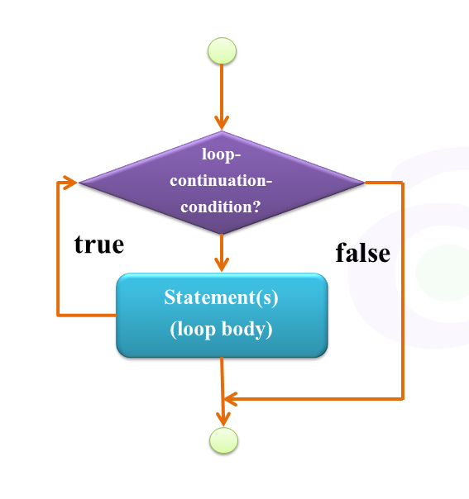
JavaScript for loop :
for loop : loops through a block of code until the given condition is true.
Syntax :
for (initialization condition inc or dec) {
Block of Statements
}
next statements…
Ex : for (var i=0 i<=10 i++) {
console.log(i)
}
console.log(“numbers printed”)

Slide 33
JavaScript for in loop :
for in loop : loops through the properties of an object or elements of an array.
Syntax :
for (iter_variable in object) {
Block of Statements
}
next statements…
Note : for in loop should not be used to iterate over an array where the index order is important. We can use normal for loop if index order is important.
Ex : var person = { ‘name’: siva , age:5 , ‘gender’:’male’ }
for (var i in person) {
console.log(i +”=“+ person[i])
}
console.log(“key value pairs printed”)
Ex : var car = [‘bmw’ , ‘benz’ , ‘audi’]
for (var i in car) {
console.log(car[i])
}
console.log(“array elements printed”)

Slide 34
JavaScript for of loop :
for of loop : allows us to iterate over arrays or other iterable objects like strings.
Syntax :
for (iter_variable of array) {
Block of Statements
}
next statements…
Note : for of loop doesn't work with objects
Ex : var car = [‘bmw’ , ‘benz’ , ‘audi’]
for (var i of car) {
console.log(i)
}
console.log(“array elements printed”)
Ex : var name = “veera raghava”
for (var i of name) {
console.log(i)
}
console.log(“letters printed”)

Slide 35
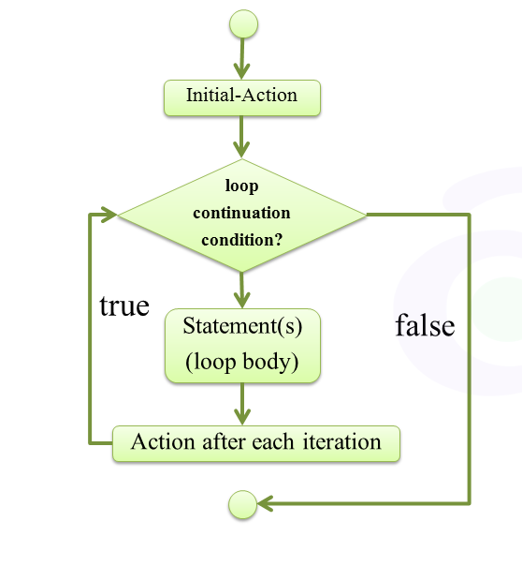
JavaScript while loop :
while loop : loops through a block of code as long as the specified condition evaluates to true.
Syntax :
while (condition) {
Block of Statements
}
next statements…
Ex : var i = 0
while (i < 10) {
console.log(i)
i++
}
console.log(“numbers printed”)

Slide 36
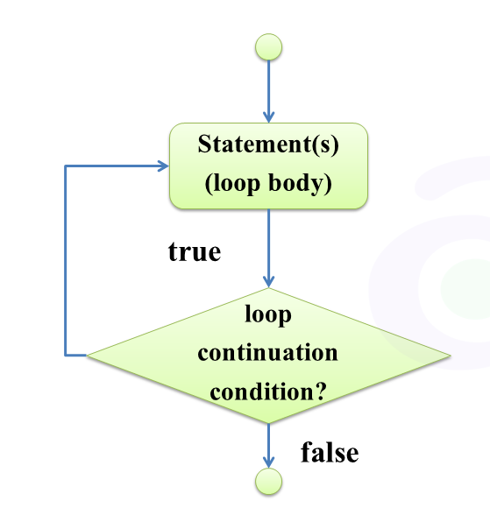
JavaScript do while loop :
do while loop : The block of code will be executed once, and then the condition is evaluated, if the condition is true, then loop continues as long as the specified condition is true.
Syntax :
do {
Block of Statements
} while (condition)
next statements…
Ex : var i = 0
do {
console.log(i)
i++
} while (i < 10)
console.log(“numbers printed”)

Slide 37
JavaScript Functions :
function is a group of statements that perform specific tasks.
Advantages of Functional Programming :
1. Code Reusability
2. Code Maintenance becomes easy
3. Debugging becomes easy
4. Modular Packages
Syntax :
function name ( ) {
Block of Statements
}
Ex : function add( ) {
var a = 10
var b = 20
var result = a+b
console.log(result)
}
Calling a function → add( )

Slide 38
JavaScript Functions :
Functions with Arguments :
Syntax :
function name(arg1, arg2, arg3…) { block of statements… }
Ex : function add( num1,num2) {
var a = num1
var b = num2
var result = a+b
console.log(result)
}
Calling a function with arguments → add(4,5)

Slide 39
JavaScript Functions :
Functions with return statement :
Syntax :
Function name (arg1,arg2… ) {
Block of Statements
return (value)
}
Input Data
Process
Output Data
Ex : function add( num1,num2) {
var a = num1
var b = num2
var result = a+b
return (result)
}
Calling a function with arguments → add(4,5)
Process
Output Data
Inputting Data as arguments

Slide 40
JavaScript Functions :
Types of Arguments:
1. Positional Arguments
2. Keyword Arguments
3. Default Arguments
4. Variable Length Arguments

Slide 41
JavaScript Functions :
Positional Arguments :
Ex : function sub (num1 , num2 ) {
console.log(“num1 =” + num1)
console.log(“num2 =” + num2)
result = num1-num2
return(result)
}
sub(20,10)
sub(10,20)
Positional Arguments

Slide 42
JavaScript Functions :
Keyword Arguments :
Ex : function sub ({num1 , num2} ) {
console.log(“num1 =” + num1)
console.log(“num2 =” + num2)
result = num1-num2
return(result)
}
sub({num1 : 20, num2:10})
sub({num2 : 10, num1:20})
Keyword Arguments

Slide 43
JavaScript Functions :
Default Arguments :
Default Arguments
Ex : function add (num1 = 5, num2 = 15 ) {
console.log(“num1 =” + num1)
console.log(“num2 =” + num2)
result = num1+num2
return(result)
}
add( )
add(10,25)

Slide 44
JavaScript Functions :
Variable Length Arguments :
Variable length Arguments
Ex : function mul (…args) {
console.log(args)
var result = 1
for (var i of args){
var result = result*i
}
return(result)
}
mul(2,5)
mul(2,5,6)
mul(8,9,6,4,5)

Slide 45
JavaScript Functions :
Assigning Functions to a Variable :
Function with specific function_name
Ex : function add (num1, num2) {
console.log(“num1 =” + num1)
console.log(“num2 =” + num2)
result = num1+num2
return(result)
}
Calling function → add(10,25)
Calling function with function name
Function don’t have specific function_name
Ex : var x = function (num1, num2) {
console.log(“num1 =” + num1)
console.log(“num2 =” + num2)
result = num1+num2
return(result)
}
Calling function → x(10,25)
Calling function with variable name

Slide 46
JavaScript Functions :
Normal Anonymous Functions :
Arrow Functions : (ES 6 Feature)
Ex : var x = function (num1, num2) {
console.log(“num1 =” + num1)
console.log(“num2 =” + num2)
result = num1+num2
return(result)
}
Calling function → x(10,25)
Arrow
Ex : var x = (num1, num2) => {
console.log(“num1 =” + num1)
console.log(“num2 =” + num2)
result = num1+num2
return(result)
}
Calling function → x(10,25)

Slide 47
JavaScript Functions
Variable Scope :
Local Variables :
Global Variables :
Ex : function wish ( ) {
var x = “Gug Morning” → local variable (variable declared inside function)
result = x
return(result)
}
Calling function → wish( )
Trying to access variable ‘x’ outside of function →console.log(x) → throws error
Ex :
var y = “hello” → global variable (variables declared outside of function)
function wish ( ) {
result = y →assigning gobal variable inside function
return(result)
}
Calling function → wish( )

Slide 48
JavaScript Functions :
Call by Value : (Numbers & Strings) Call by Reference : (Objects)
Note : changes inside the function will not be Note : changes inside the function will be
reflected back in outside variables which reflected back in outside variables which
are used as arguments. are used as arguments.
Ex : function add (num1, num2) {
console.log(“num1 =” + num1)
console.log(“num2 =” + num2)
num1 = num1 + 1
num2 = num2 + 1
result = num1+num2
return(result)
}
var a = 10 , b = 20
Calling function → add(a,b)
Ex : function mod (obj) {
console.log(“obj =” + obj)
obj[3] = 40
result = obj
return(result)
}
var a = [10 , 20 , 30 ]
Calling function → mod(a)

